Slide 1
ManagerialEconomics
Introduction

Slide 2
Introduction
The study of Economics has expanded to include vast range of topics like
Explores the behavior of financial markets including interest rates and stock prices.
Examines the reason why some countries or people have high incomes while others are poor and suggests ways that incomes of poor can be raised without harming the economy.
Studies business cycles
Studies international trade and finance and the impacts of globalization
Looks at growth in developing countries
Asks how government polices can be used to pursue important economic goals such as rapid economic growth, efficient use of resources, full employment, price stability and a fair distribution of income.

Slide 3
Economics- ‘oikonomos’
‘Oikonomos’ means ‘one who manages a household’
Household and economies have much in common.
Household faces many decisions like economy.
Household | Economy
Who should do what? (production) | Who should do what? (Production)
What to consume and how much in quantity? (consumption) | What to consume and how much in quantity?
How to allocate the household resources? | How to allocate economy’s resources?
How to distribute among themselves? (distribution) | How to distribute among people?

Slide 4
Three Economic Problems of Economic Organisation
What commodities are produced and in what quantities?
How much of each possible goods and services it will make and when they will be produced?
How are goods produced?
Who will do the production and with what resources? What production technique? Who farms and who teaches?Is electricity generated from coal, oil or sun?
For whom goods are produced?
who gets to eat the fruit of economic activity?Is the distribution of income and wealth fair and equitable? Are many people poor and few are rich? Do high income goes to teacher or atheletes or autoworkers or venture capitalist?

Slide 5
Definition: Economics
Economics is “the study of how societies use scarce resources to produce valuable commodities and distribute among different people”.
Behind this definition are twin themes of Economics
Scarcity means the limited nature of society’s resources, given society’s unlimited wants and needs.
Efficiency means the most effective use of a society’s resources in satisfying people’s wants and needs.
Equality means the property of distributing economic prosperity uniformly among the members of the society.

Slide 6


A World Without a Scarcity

Slide 7
Free Goods Vs Economic Goods
Free Goods
Goods which exist in such large quantities that they need not be rationed out among those wishing to use them. Thus their market price is zero.
Example: Air or Sea water
Economic Goods
A good that is scarce relative to the total amount of it desired. It must be therefore rationed usually by charging a positive price.
Economic Goods which uses scarce resources in Production.

Slide 8
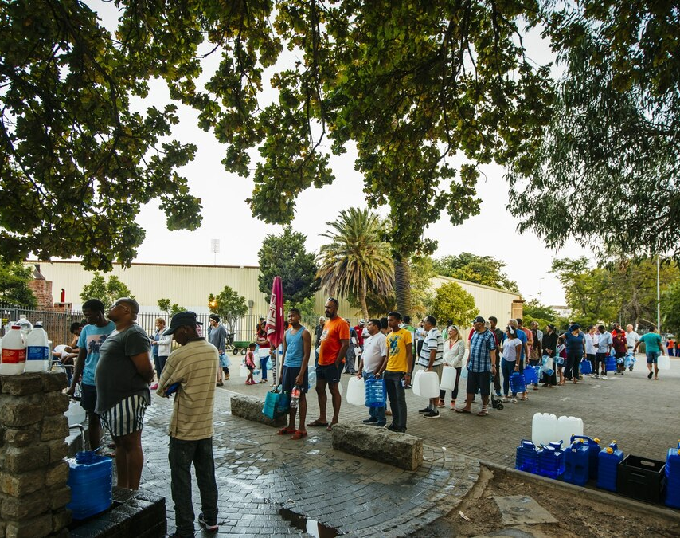
Water Scarcity
The Cape Town water crisis in South Africa was a period of severe water shortage in the Western Cape region, most notably affecting the City of Cape Town.
While dam water levels had been decreasing since 2015, the Cape Town water crisis peaked during mid-2017 to mid-2018 when water levels hovered between 14 and 29 percent of total dam capacity.
Extreme Drought from 2015-2017
Bad Planning and Infrastructure

Slide 9
Efficiency vs Scarcity
Number of Hospitals and Hospital Beds
Total Population - 1,428,627,663 (2023 United nations Data)
From National Health Profile -2022
Total 7,39,024 government hospital beds
This amounts 0.55 beds per 1000 population

Slide 10
Boeing and Airbus
Case study

Slide 11
Airbus and Boeing
Airbus and Boeing comprise a duopoly in the manufacture of large commercial jet aircraft (with 150 or more seats). Boeing’s is most successful and profitable plane is the Boeing 737, a twin-engine, single-aisle, medium-range jet. First flown in 1967, the Boeing 737 has been developed into nine models. As of December 2010, Boeing had delivered 6,687 units of 737 with a further 2186 on order. The Boeing 737 competes with Airbus’s A320 family comprising five models, the A318, A319, A320, A321, and ACJ business jet. According to Boeing forecasts, airlines would buy 23,370 new single-aisle planes in the next 20 years.
However, at the Paris Air show in June 2011, Jim Albaugh, CEO of Boeing Commercial Airplanes, conceded: The days of the duopoly with Airbus are over”. Manufacturers from China, Canada, Russia, and Brazil have developed, launched, or are poised to launch new aircraft to compete with Boeing’s 737 and Airbus’s A320 family.

Slide 12
In 2006, the predecessor to the Commercial Aircraft Corporation of China (COMAC) launched the C919, a 150-seat single-aisle plane. The C919 is scheduled to fly in 2014 and begin commercial deliveries in 2016. In November 2010, COMAC announced another 100 orders, mainly from three Chinese carriers-Air China, China Southern Airlines, and China Eastern Airlines.
Another entrant to the market for 150-seatsingle-aisle jets is the Canadian Manufacturer, Bombardier. Bombardier had long manufactured regional jets, which are smaller short-range planes with up to 100 seats. It aspired to expand into larger aircraft, but only began development in 2008 upon securing an order from Deutsche Lufthansa. The new C Series, a family of 100 to 149-seat aircraft, is scheduled to enter service in 2013. The C Series will reduce fuel consumption by 20% through the use of advanced materials and a more fuel-efficient engine the PW1000G from Pratt &Whitney.

Slide 13
Two other entrants are Irkut of Russia and Embraer of Russia. Primarily a manufacturer of military aircraft, Irkut is seeking to diversify into commercial jets. It launched the MC-21 in 2007 and secured orders from Russian airlines. The MC-21 is scheduled to enter service around 2016.
Embraer like Bombardier, is an established manufacturer of regional jets. However, as of June 2011, it had not secured any orders and deferred a decision on whether to commence development. CEO Frederico Curado remarked: Going up against Boeing and Airbus in head-to-head competition is really tough not only because of their size, but because of their existing product line and industrial capacity. They can have a very quick response and literally flood the market. Moreover, Tom Enders, CEO of Airbus, cautioned that there might not be sufficient room for six manufacturers.

Slide 14
In December 2010, Airbus announced that it would develop a new version of the A320-the A320neo (New Engine Option). The A320neo would be powered by either CFM International’s LEAP-X engine or the engine in Bombardier’s C Series, Pratt & Whitney’s PW1000G. In March 2011, Airbus announced that it would raise production of the 320 family from 34 to 36 units per month.
Boeing’s Jim Albaugh acknowledged that the C Series 300 appeared to target customers of the Boeing 737. He insisted that Boeing would respond: “I look at the 737 business that we have, and it is one of the cornerstones of Boeing Commercial, and it is a marketplace we are going to defend”. Just before the Paris Air Show, Boeing announced an increase in production of the Boeing 737 from 31.5 to 42 units per month.

Slide 15
Why did Bombardier wait until securing orders from Lufthansa before launching the C Series?
Why does Bombardier emphasize the fuel efficiency of its C Series?
Who among the new entrants that have commenced development- Bombardier, COMAC, and Irkut- has the best chance of succeeding in competition with Boeing and Airbus? Should Embraer stay out of the market?
What about Boeing? How should it respond to a new entry? Should it launch a new product or, like Airbus, modify its existing plane?
Did it make sense to expand production of the 737?
Why did Airbus respond to the entry of Bombardier and COMAC with a new version of A320 rather than a totally new plane?
All these questions are answered by Managerial Economics.

Slide 16
Managerial Economics
Managerial economics is the science of cost-effective management of scarce resources. Wherever resources are scarce, managers can make more cost-effective decisions by applying the discipline of managerial economics. The decisions may regard customers, suppliers, competitors, or the internal workings of the organization. Whether the organization is a profit-oriented business, non profit organization, or a household, managers must make the best use of scarce resources.

Slide 17
Managerial Economics
Managerial Economics refers to the application of economic theory and the tools of analysis of decision science to examine how an organizationn can achieve its aims or objectives most efficiently.
Management decision need to be made in any organisation be it a firm, a not for profit organisation or a government agency when it seeks to achieve some goal or objective subject to some constraints.
A firm may seek to maximise profits subject to limitations on the availability of essential inputs and in the face of legal constraints.
A hospital may seek to treat as many patients as possible at an adequate medical standard with its limited physical resources (physicians, technicians, nurses, equipments, beds) and budget.
The goal of a state university may be to provide an adequate education to as many students as possible subject to physical and financial constraints it faces.

Slide 18
Types of Economy
Market Economy ,Planned Economy and Mixed Economy
Market Economy is one in which the individuals and private firms make the decision about production and distribution.
The extreme case of market economy in which the government keeps its hands off economic decision is called laissez faire economy.

Slide 19
Planned or Command Economy is one in which government makes all important decisions about production and distribution.
For example Command Economy which operated in the Soviet Union during 20th century.
The government owns the most of means of production. It also owns and directs the operations of enterprises in most industries. It is employer of most of workers and tells them how to do their job.
It decides how the output of the society is to be divided among different goods and services.
Mixed Economy with elements of market and government plays important role in decision making.

Slide 20
Economics
Resource allocation
Scarcity
Efficiency vs Equality
Decision Making
Interaction
Economy as whole

Slide 21
Foundations of Economics
How People Make decisions?
Principle 1: People face TRADE OFF
Principle 2: The cost of something is what you give up to get it- OPPORTUNITY COST
Principle 3: Rational people think at MARGIN
Principle 4: People Respond to INCENTIVES
How People Interact?
Principle 5: Trade can make everyone better off
Principle 6: Markets are usually a good way to organize economic activity
Principle 7: Government can sometimes improve market outcomes.

Slide 22
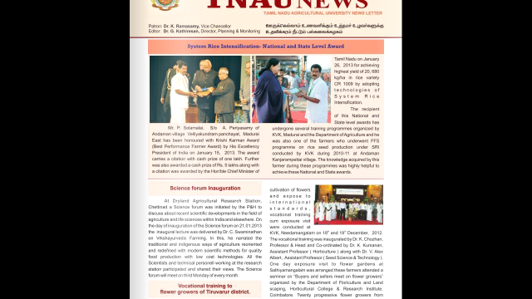

Slide 23
Decision Making by a Agricultural Farmer
A technological advance in an industry enables the country to produce more commodities for any given number of another commodity.
Example: System of Rice Intensification
Mr. Solaimalai, who owns two hectares of land and had leased another two hectares in Andaman village in Madurai district, had set a record by producing 13,787 kilograms/ha of rice (or 20,680 kilo/ha of paddy) during the 2011-12 kharif season.
Techniques such as land levelling, use of bio-fertilisers and organic manure in the paddy variety – CR 1009 – had ensured the highest yield for the winner. In the previous season,
Before 2011-12- harvested 8,125 kilos of paddy per hectare.

Slide 24

Firm or Business Organisation
Profit
Faces Many Decisions
What to Produce?
How to Produce?
For Whom to produce?

Slide 25
Examples of Decision Making at the Firm Level
Deciding the price of a product and the quantity of the commodity to be produced
Deciding whether to manufacture a product or to buy from another manufacturer
Choosing the production technique to be employed in the production of a given product
Deciding on the level of inventory a firm will maintain of a product or raw material
Deciding on the advertising media and the intensity of the advertising campaign
Making employment and training decisions
Making decisions regarding further business investment and the mode of financing the investment

Slide 26
Pharmaceutical Company
A five-year-old pharmaceutical company faces a major research and development decision.
It already has spent a year of preliminary research toward producing a protein that dissolves blood clots. Such a drug would be of tremendous value in the treatment of heart attacks, some 80 percent of which are caused by clots.
The primary method the company has been pursuing relies on conventional, state-of-the-art biochemistry.
Continuing this approach will require an estimated $10 million additional investment and should lead to a commercially successful product, although the exact profit is highly uncertain.

Slide 27
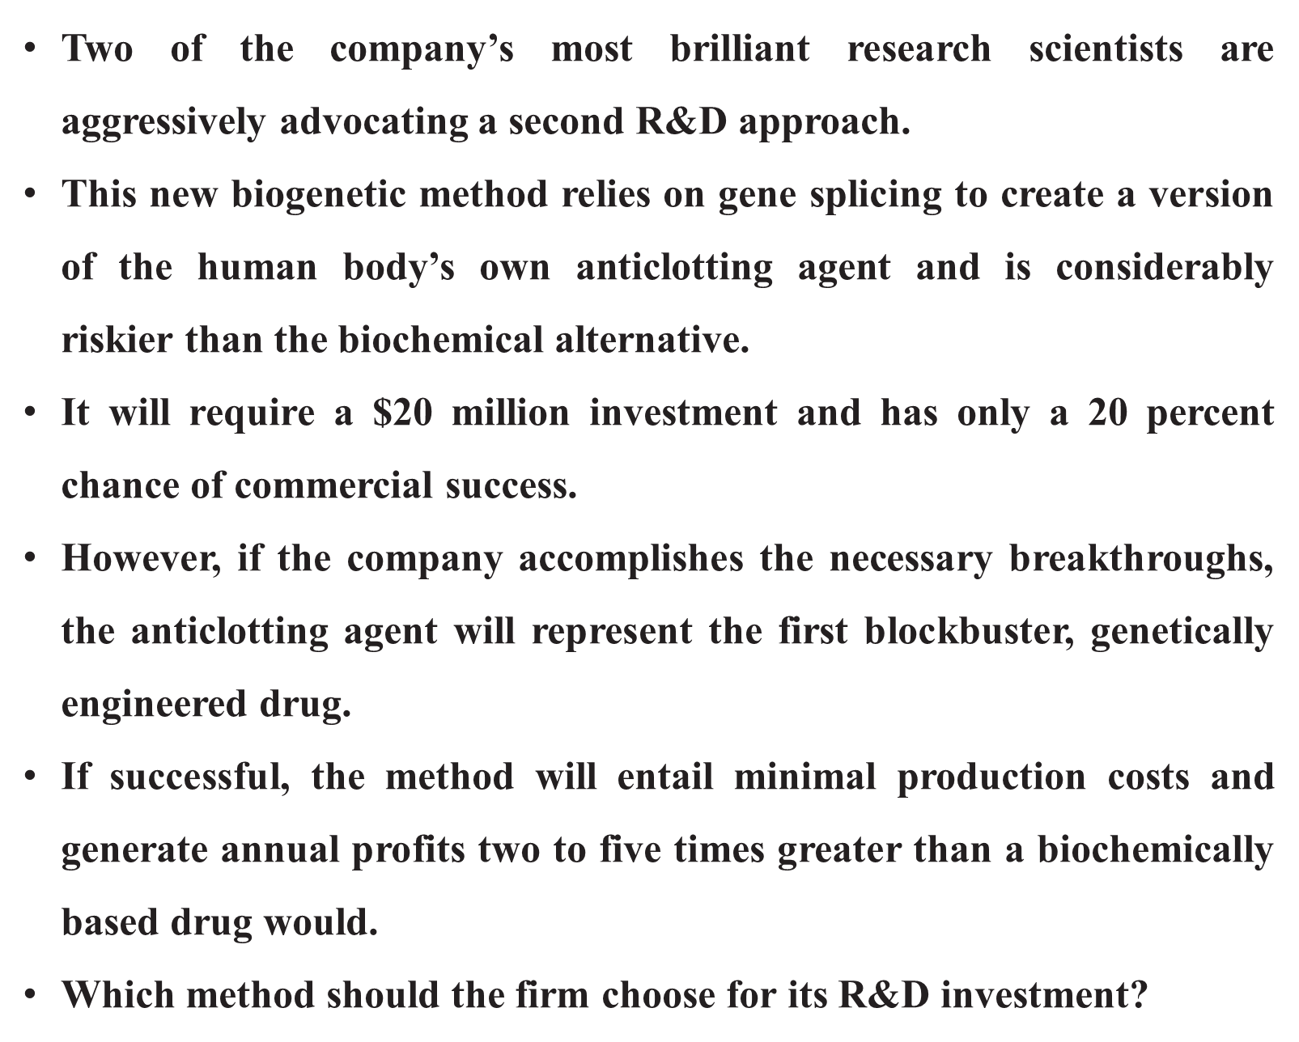
Pharmaceutical Company

Slide 28

Non Profit Hospital
While a nonprofit hospital is not like a typical firm seeking to maximize its profits,
A hospital does strive to provide its patients the best medical care possible given its limited staff (doctors, nurses, and support staff), equipment, space, and other resources.
The hospital administrator can use the concepts and tools of economics to determine the optimal allocation of the limited resources available to the hospital.

Slide 29
How People make decisions?
Principle 1: People face trade off –make decision-choose one and give up all other choices.
Economic actors | Resource | Choice 1 | Choice 2 | Choice 3
Individuals/Household | Time | Work for 8 hrs | Full time work | Part time job
 | land | Cultivate | No cultivation | Give for lease
 | Finance | Health, education ,house | Savings | Spend on luxury goods
 | Buildings | Own use | Rent out | Not in use
Firms | Annual profit | Invest in expansion | Future investment | New machinery or technology
Society | Environment, clean air, labour force | Industries | Roads and transportation | Protect the environment

Slide 30

Olympics Beijing 2008
Trade off faced income/GDP for clear air/healthy environment to conduct the show
One year before Olympics
Temporarily shut down of factories
Use of automobiles to reduce smog
In developed countries-clean environment-better standard of living-additional income.

Slide 31
OPPORTUNITY COST
Opportunity cost “is the highest valued alternative that must be sacrificed in order to get something else”.
Every time when choice is made, there will be opportunity cost.
The key to best possible decision is to minimize opportunity cost by choosing the option that gives the largest benefit.
Applies to Individuals, firms and society as well.

Slide 32
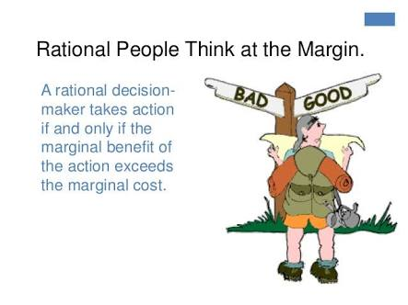
Rational People Think at Margin

Slide 33
Rational People Think at Margin -Example
Flying 200 seat plane costs $ 1,00,000
Average cost $1,00,000/200 = $ 500
Plane about to take off-standby passenger willing to pay $300
Marginal cost (bottle of water and packet of peanuts)

Slide 34
Diamond and Water Paradox
Water, which is demanded by everyone, is extremely cheap. But diamonds, who are demanded only by the very few, are incredibly expensive.
The paradox is, “how can something for which there is so little demand be so expensive?” The solution to this riddle is that the value of something is based not only on the demand for it, but also on its supply.
Scarcity, in other words, is a function of both supply and demand. Diamonds are incredibly expensive because, despite their limited demand, their supply is so extremely limited that they are deemed to have great value. Water, despite its high demand, is in such abundant supply that it is very cheap

Slide 35
People respond to Incentives
Incentives are factors that motivate a person to act or exert effort.
Positive Incentive
Negative Incentive
Direct Incentive and Indirect Incentive

Slide 36
Employees Provident Fund Scheme (EPFS)
Employees Provident Fund Scheme (EPFS) is a long-term retirement saving scheme managed by Employees provident fund organization (EPFO) and it is covered under the Employees’ Provident Funds and Miscellaneous Provisions Act, 1952.
Under EPF Scheme, an employee and employer have to pay certain percentage of equal contribution in the provident fund account and on retirement, an employee gets a lump sum amount of contribution made by employer and employee with interest on both.

Slide 37
Employment Linked Incentives
Scheme A : Will provide one Month’s salary as an incentive to first time employees entering the formal sector and registering with Employee Fund Organisation (EPFO). This will be upto Rs. 15000 in three instalments. This is expected to benefit 210 lakh employees.
Scheme B: Aims to help create jobs in manufacturing. It provides EPFO incentives linked to the scale of hiring to both employers and employees over the first four years of new hiring. It aims to benefit 30 lakh workers.
Scheme C : targets employers, reimbursing up to Rs. 3000 per month of Employers’s contributions to the EPFO for two years. The workers must be new contributors EPFO and have salary below Rs. 1 lakh/month. This is expected to benefit 50 lakh new workers.

Slide 38

Incentives and Innovation
Incentives play a vital role in innovation, the engine of economic growth.
Patents and copyright laws
Maintaining right rewards or incentives for hardwork innovation is essential for advancing our society.

